Slide 1
Movie recommendation system

Slide 2
Sprint goals recap:
Create design user interface
Create frontend and backend, integrate them together
Start working on frontend components
Deploy pipeline

Slide 3
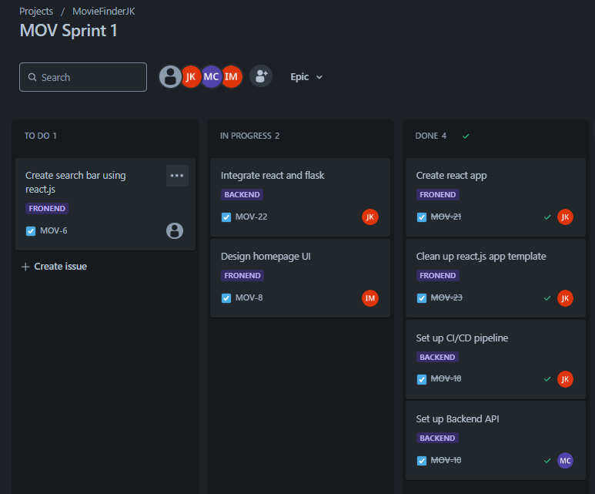
Demonstration of completed work:

Slide 4
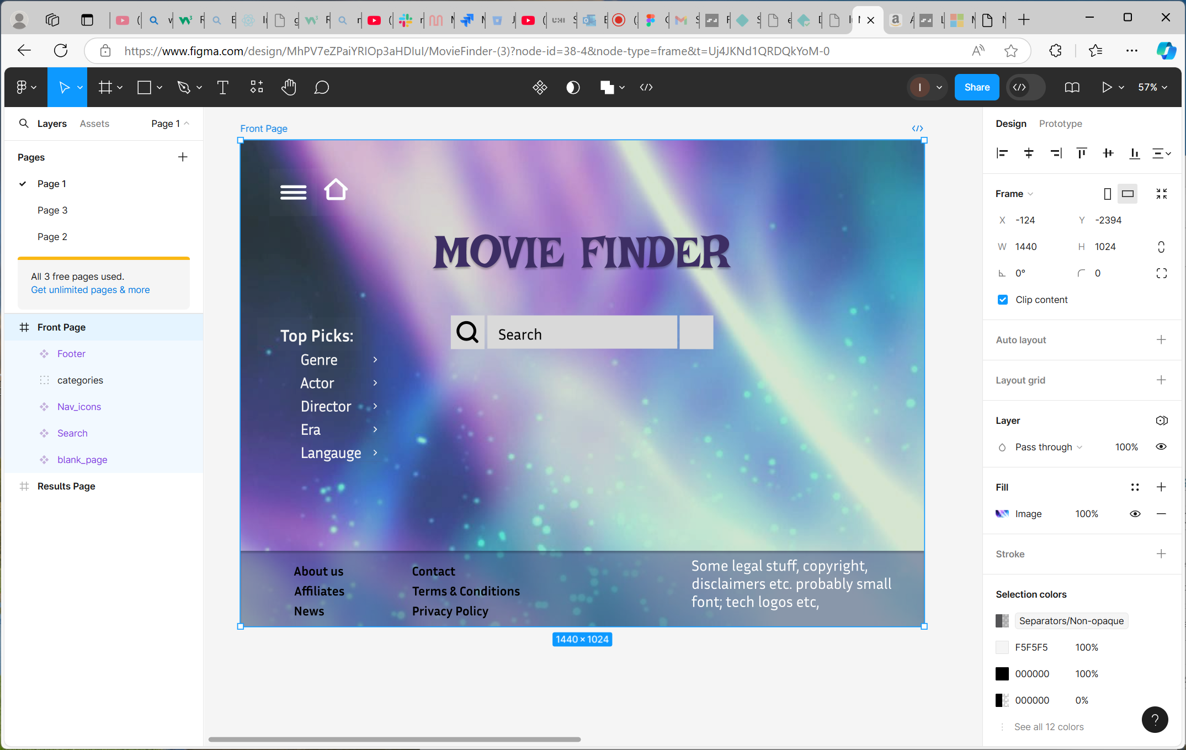
Design

Slide 5
Setting up the server

Slide 6
Our challenges

Slide 7
Thank you
Presented by:
Julia – project leader, dev team
Martin – scrum master, dev team
Antonio – dev team
Iain- dev team

